Slide 1

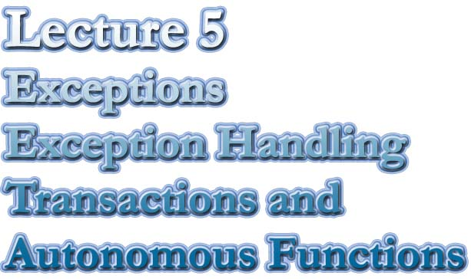

Slide 2
Exceptions
  What is an Exception
  Different types of Exceptions
  Predefined Exceptions
  User Defined Exceptions
  Exception Scope
  Exception Propagation
  RAISE_APPLICATION_ERROR

Slide 3

Exceptions in PL*SQL
Most programmers write programs with the assumption that nothing will go wrong. If the program fails, it is due to ‘user error’.
We often ask, ‘Why did you press that key?’
We tend to write applications that assume a perfect world
  The program is bug-free
  The users always enter correct data
  The hardware and software systems that we work in are stable and will never fail.
In time, all good programmers learn to be defensive. Some longer than others
It is in their best interest as well as the organisations.

Slide 4
What’s an Exception?
An exception is an unusual/erroneous condition
encountered during execution: (run time error)
Some causes Include
system error (e.g. "out of memory")
error caused by user program (Never, I hear you say)
warning issued by application
PL/SQL's exception handling allows these to be
handled "cleanly" in a central place.

Slide 5
DECLARE
-- variable Decleration
BEGIN
-- The body of the Module
EXCEPTION
-- exceptions are handled here
END;
Exceptions
Remember the block structure?
When an error occurs, control automatically passes to the exception part of the block.
(if it exists)
You write exception handlers to gracefully deal with the error.
Each exception has a number, but exceptions must be handled by name
Once the exception is handled, control CAN NOT return to the same block
Control will pass to the enclosing block or
the program will abort if there is no enclosing block

Slide 6
create or replace function is_it_number(p_value IN VARCHAR2)
RETURN BOOLEAN
IS
--
v_numberOK NUMBER;
--
BEGIN
--
v_numberOK := TO_NUMBER(p_value);
RETURN TRUE;
--
EXCEPTION
WHEN VALUE_ERROR THEN
DBMS_OUTPUT.put_line('Invalid number '||p_value);
RETURN FALSE;
END;
If this conversion fails then an
exception will be raised automatically
Bad practice! Why?
Function should only return a value
Lets test it
set serveroutput on
BEGIN
IF is_it_number('A1234') THEN
DBMS_OUTPUT.PUT_LINE('Number_OK');
ELSE
DBMS_OUTPUT.PUT_LINE('Invalid Number');
END IF;
END;

Slide 7
Exception Types
In previous example we used a Predefined exception
called VALUE_ERROR
There are many Predefined Exceptions. They are defined globally in the Database. You only need to write handlers for them.
You will find a list of predefined exceptions together with the description in your textbook on page 134
To handle errors that are not predefined use the OTHERS handler. This is a catch all.
The functions SQLCODE and SQLERRM are useful when using OTHERS. They return the error number and the error message.

Slide 8
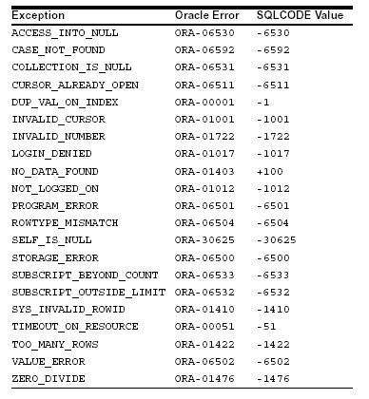
List of Predefined exceptions
Refer to the textbook
Oracle PL/SQL Programming
on page 134
For a full description of
Predefined exceptions

Slide 9
Lets generate an unhandled error
create or replace function is_it_number(p_value IN VARCHAR2)
RETURN BOOLEAN
IS
--
v_numberOK NUMBER;
--
BEGIN
--
v_numberOK := to_number(p_value) / 0;
RETURN TRUE;
--
EXCEPTION
WHEN VALUE_ERROR THEN
DBMS_OUTPUT.put_line('Invalid number '||p_value);
RETURN FALSE;
WHEN OTHERS THEN
DBMS_OUTPUT.put_line('Unhandled error occured');
DBMS_OUTPUT.put_line(SQLCODE||' - '||SQLERRM);
RETURN FALSE;
END;
Dividing by zero
Lauries Note
If the number is valid then an
error will not occur there, but the
divide by zero will generate a
problem
BEGIN
IF is_it_number('1234') THEN
DBMS_OUTPUT.PUT_LINE('Number_OK');
ELSE
DBMS_OUTPUT.PUT_LINE('Invalid Number');
END IF;
END;
Unhandled error occured
-1476 - ORA-01476: divisor is equal to zero
Invalid Number
PL/SQL procedure successfully completed.

Slide 10
User defined exception
So far we looked at the exceptions that are defined for us.
We can define our own exceptions and then RAISE those
exceptions.
In the EXCEPTION section of the block we code a handler
with the WHEN clause.
Oracle has many error codes that are not associated
to a predefined exception NAME
We can use the PRAGMA**, EXCEPTION_INIT to bind an
error code to a user defined exception.
(See page 131) Talk about saving these error codes into a package - standardization
**A pragma is a compiler directive that is processed at compile time, not at run time.

Slide 11
Defining Your Own PL/SQL Exceptions I
DECLARE
out_of_stock EXCEPTION;
number_on_hand NUMBER(4);
BEGIN
...
IF number_on_hand < 1 THEN
RAISE out_of_stock;
END IF;
EXCEPTION
WHEN out_of_stock THEN
-- handle the error
END;
1
2
3
Declare an EXCEPTION
RAISE the exception
Handle the exception
RAISING an exception passes control
to the EXCEPTION part of the block

Slide 12
Defining Your Own PL/SQL Exceptions II
binding the exception to an ORACLE error code
DECLARE
deadlock_detected EXCEPTION;
PRAGMA EXCEPTION_INIT(deadlock_detected, -60);
BEGIN
... -- Some operation that causes an ORA-00060 error
EXCEPTION
WHEN deadlock_detected THEN
-- handle the error
END;

Slide 13
Scope and propagation of an Exception
The scope of an exception is that portion of code that
is covered by that exception
Also consider a call from other modules
BEGIN
BEGIN
Error RAISED in a Inner block
System jumps to EXCEPTION in
that block. (Handled if found)
If exception not found then control
passes to exception in enclosing
bloc. (Handled if found)
Repeat until the error is caught or
the system aborts program
and returns to the operating system
BEGIN
EXECUTING CODE
ERROR
BLOCK 3
BLOCK 2
BLOCK 1
EXCEPTION
EXCEPTION
EXCEPTION
O/S

Slide 14
RAISE_APPLICATION_ERROR
RAISE_APPLICATION_ERROR is a special built-in
procedure provided by the ORACLE compiler.
The procedure allows you to issue a user-defined ORA error
messages from stored subprograms. That way, you can
report errors to your application and avoid returning
unhandled exceptions.
To call RAISE_APPLICATION_ERROR, use the syntax
raise_application_error(error_number, message);
where error_number is a negative integer in the range -20000 .. -20999 and
message is a character string up to 2048 bytes long.
Memory jogger Use RAISE_APPLICATION_ERROR to abort a program

Slide 15
RAISE_APPLICATION_ERROR Example
CREATE PROCEDURE raise_salary (p_emp_id NUMBER, p_amount NUMBER) AS
v_curr_sal NUMBER;
BEGIN
SELECT sal INTO v_curr_sal
FROM emp
WHERE empno = p_emp_id;
IF v_curr_sal IS NULL THEN
/* Issue user-defined error message. */
raise_application_error(-20101, ’Salary is missing’);
ELSE
UPDATE emp
SET sal = v_curr_sal + p_amount
WHERE empno = p_emp_id;
END IF;
END raise_salary;
Lauries Note
Talk about a lost update
The calling application gets a PL/SQL exception, which it can process using the
error-reporting functions SQLCODE and SQLERRM in an OTHERS handler.

Slide 16
Exception Conclusion
Robust and consistent error handling is an absolute
crucial element of a properly constructed application.
When your code is taken from you and moved into
production, the way it performs will determine the
programmer that you are.
In PL*Sql Exceptions are a vital means of writing
dependable, intuitive and ‘user friendly’ code.
You MUST learn how to use exceptions effectively

Slide 17

Chapter 13 Page 439
Transactions and
Autonomous Transactions
The ORACLE database as with most other
commercial databases provide a very
robust transaction model.
(as you would expect from a relational database)
A transaction is a logical unit of work which must be
either committed or Rolled back.
A transaction implicitly begins with the first SQL statement
issued since the last commit or rollback
Your application code will determine what constitutes
a transaction.

Slide 18
Transactions
The environment that your program runs in defines a session
Any COMMIT or ROLLBACK issued in your session will
make any and all of your changes permanent.
You must be very careful how you handle data updates or
inserts.
If you issue a periodic commit in your code then you should
consider what would happen if the program fails before it
completes.
Lets look at an example

Slide 19
DECLARE
CURSOR c1 is SELECT ordno, empno
FROM ordertbl
WHERE empno is NOT NULL
AND orddate = sysdate;
BEGIN
FOR r1 in C1 LOOP
-- For each order determine the total amount
-- Calculate the commission for the employee
-- UPDATE the employee commission amount with the new value
COMMIT;
END LOOP;
COMMIT; -- The commit could go here too
EXCEPTION
WHEN OTHERS THEN
ROLLBACK;
END;

Slide 20
Autonomous Transactions
Before ORACLE 8i, each session could have only one active
transaction at a given time. This was seen as a drawback
of PL*SQL. Developers wanted the ability to perform some
DML statements without affecting the overall sessions
transaction.
That ability is now available with the use of Autonomous
transactions.
With a Autonomous Transaction block, the main transaction
is suspended while the autonomous transaction is performed
The main transaction is resumed when control returns to
the main block.

Slide 21
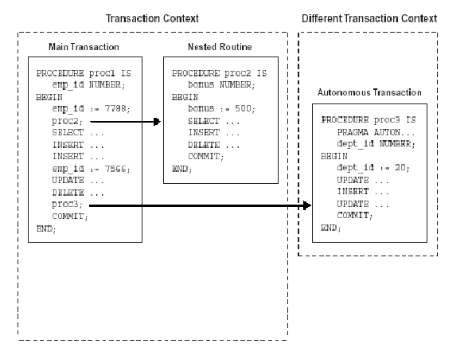
Autonomous Transactions Diagram
PROCEDURE
PROCEDURE
PROCEDURE
INSERT
UPDATE
DELETE
Main transaction to have only one COMMIT/ROLLBACK
COMMIT in AT does not affect the main transaction

Slide 22
Autonomous Transactions
What are the benefits?, I hear you ask
Allows logging to be performed
Look at book for other stuff.
How to create an Autonomous Transaction
PROCEDURE log(p_message VARCHAR2, p_msg_id VARCHAR2 default null) is
PRAGMA AUTONOMOUS_TRANSACTION;
BEGIN
insert into dbp_message_log(MESSAGE, MSG_ID)
values(p_message, p_msg_id);
COMMIT;
EXCEPTION
when others then
DBMS_OUTPUT.PUT_LINE('Error encountered trying to insert a log record');
DBMS_OUTPUT.PUT_LINE('Error message: '||SQLERRM);
RAISE; --Consider reraising the error
end;
Note
This commit applies to the Transaction in this scope only

Slide 23
Summary
Transaction Management is a very complicated topic.
We can only touch the surface of the subject.
You are encouraged to engage in additional study and
experimentation on the topic.
Autonomous Transactions are a new feature in the
Oracle database, introduced in response to demand
from developers.
Autonomous Transactions provide versatility and loosen
the shackles of traditional Transaction management,
particularly in todays’ more distributed and disjointed
environment of the Internet and e-commerce

